Slide 1
Food Lover (Internship project) Presentation Slides
Supervised By
Satyaki Das
Lecturer
University of Liberal Arts Bangladesh
Submitted By
Name: Md. Meshkat
ID: 162014015
Computer Science And Engineering Dept.

Slide 2

Company Profile
MUNSHIELD Ltd.
Address : House: #77, Road: #07,Mohammodpur, Dhaka-1207.
Contact Number : +88 0130 999 2053
Email : hr.admin@munshield.org
Website : https://munshield.org/

Slide 3
Working Period And Position
Designation : Junior Web Developer.
Working Period : 01 February 2020 to 05 May 2020
Time Frame for my project:
Month 1 | Month 2 | Month 3
Information gathering + System design | Frontend coding + Features | Backend coding

Slide 4
So, What is Food Lover And what it Does?
A platform for health concerned people.
Provides balance diet based on their priorities.
Personalized Nutritionist.
Get tasty meal.
Doorstep Delivery.

Slide 5



PREREQUIREMENTS
HTML
CSS
JavaScript
OOP
PHP
Frameworks : LARAVEL, Bootstrap

Slide 6




Tools that are used:
XAMPP
IDE (Sublime, Visual Studio code)
Composer
Web browser

Slide 7
The Objectives And The Challenges of the project :
Objectives:
Provide Website Platform for them.
Explore to extract the market demand.
Designing and developing the website.
Improving my soft skills
Challenges:
How to use and build Full Stack Website using popular framework (LARAVEL).
How to make Responsive Website.
Suggest new product ideas
Database connection ( Back-end Work).

Slide 8
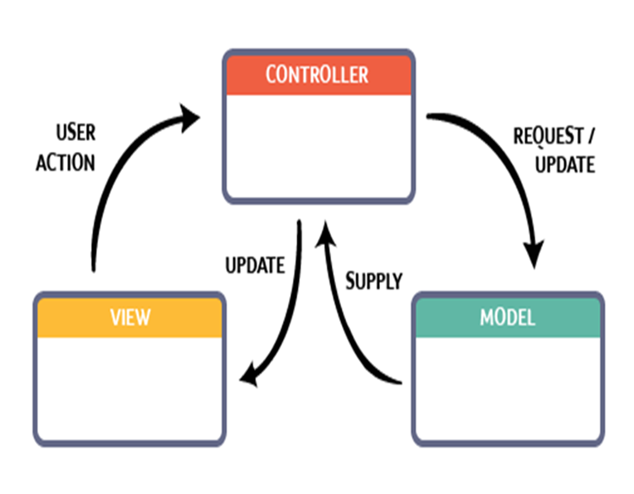
A Short Description About The Framework
LARAVEL is an open-source PHP framework designed to make developing web apps easier and faster through built-in features.
It has A complete authentication system and Object-relational mapping.
LARAVEL takes care of the security within its framework,
With LARAVEL framework database migrations is extremely easy,
Automatic Package Discovery,
Clean documentation and Model View Controller (MVC) support

Slide 9
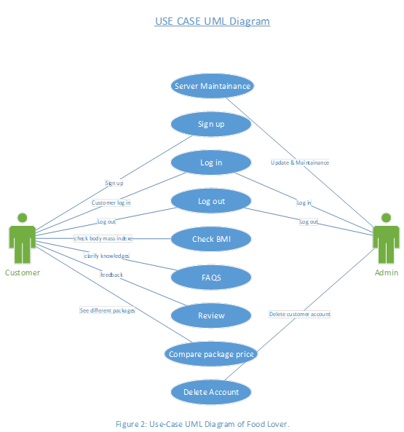

Slide 10
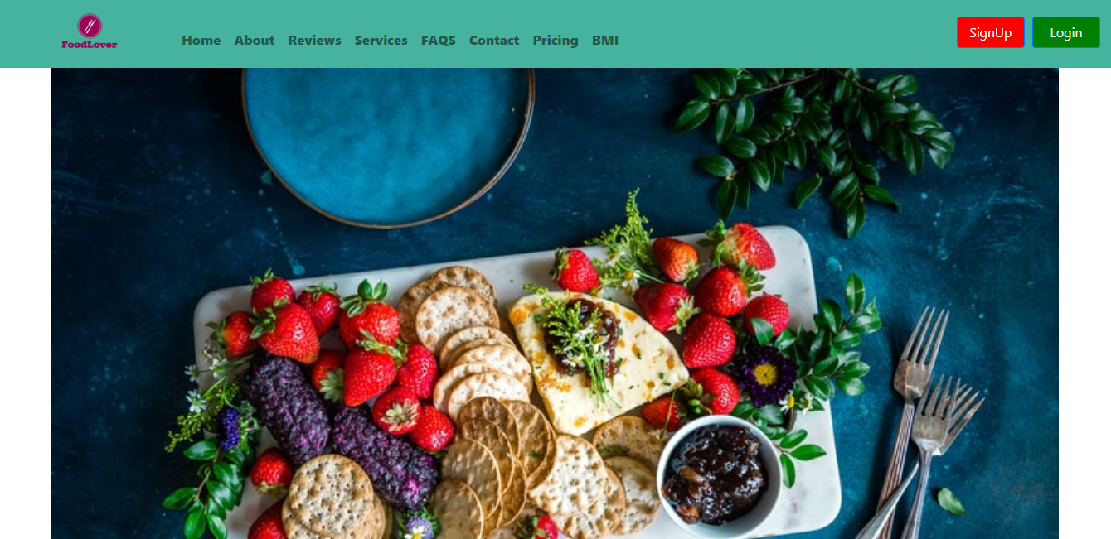
Implemented Work:
Figure-3: First Look designed for Food Lover.

Slide 11
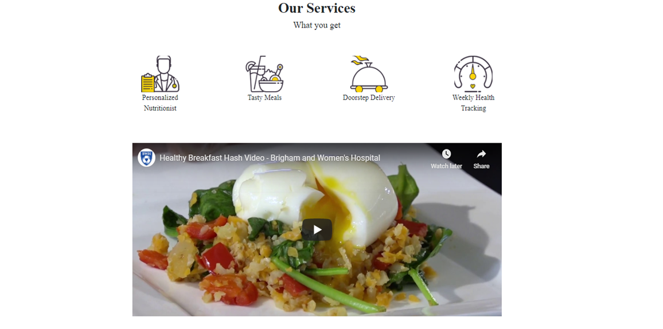
Implemented Work cont'd
Figure-4: Service section design for Food Lover.

Slide 12
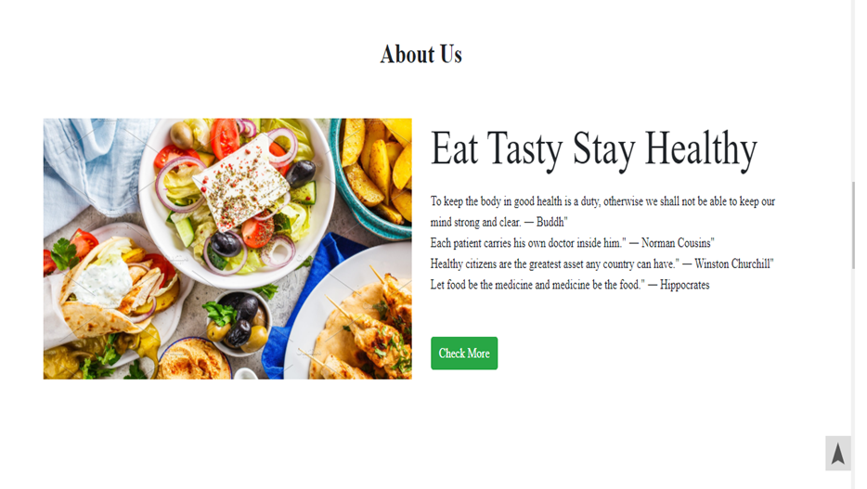
Implemented Work cont'd
Figure-5: About section design for Food Lover.

Slide 13
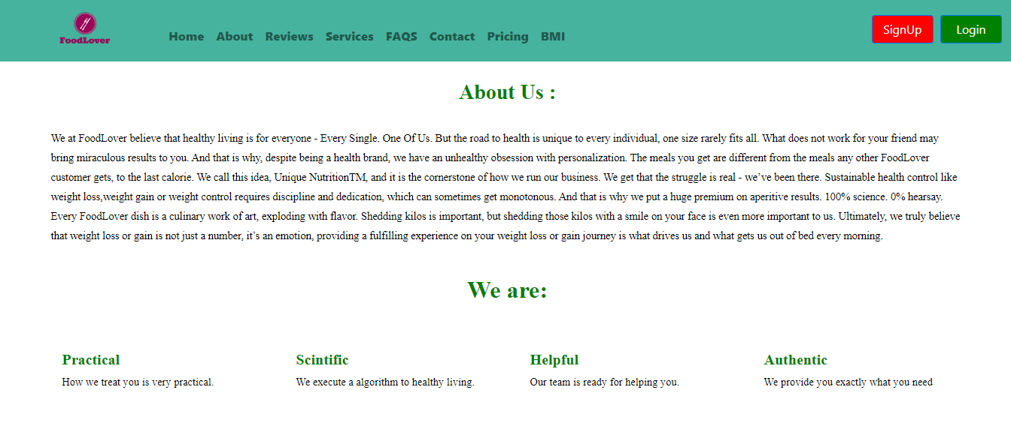
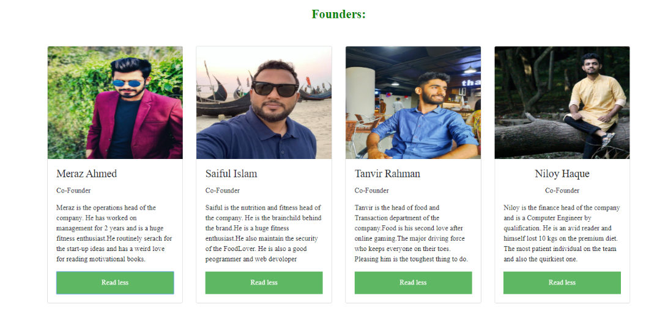
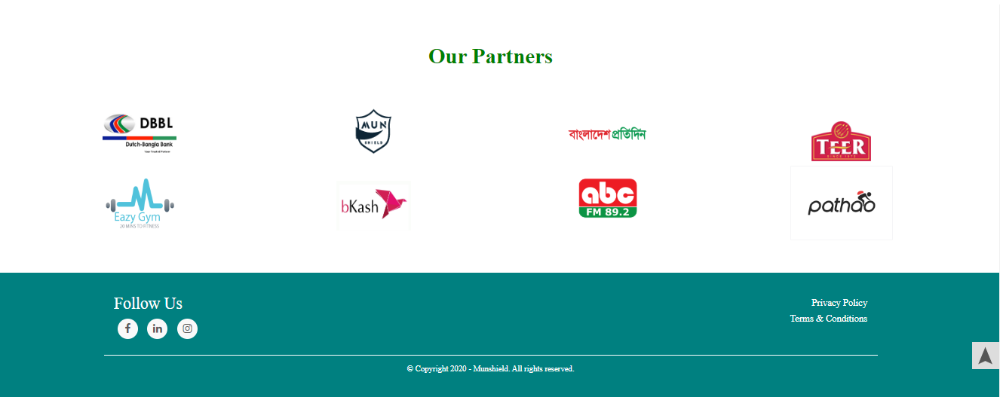
Figure-6: full view of about page.

Slide 14
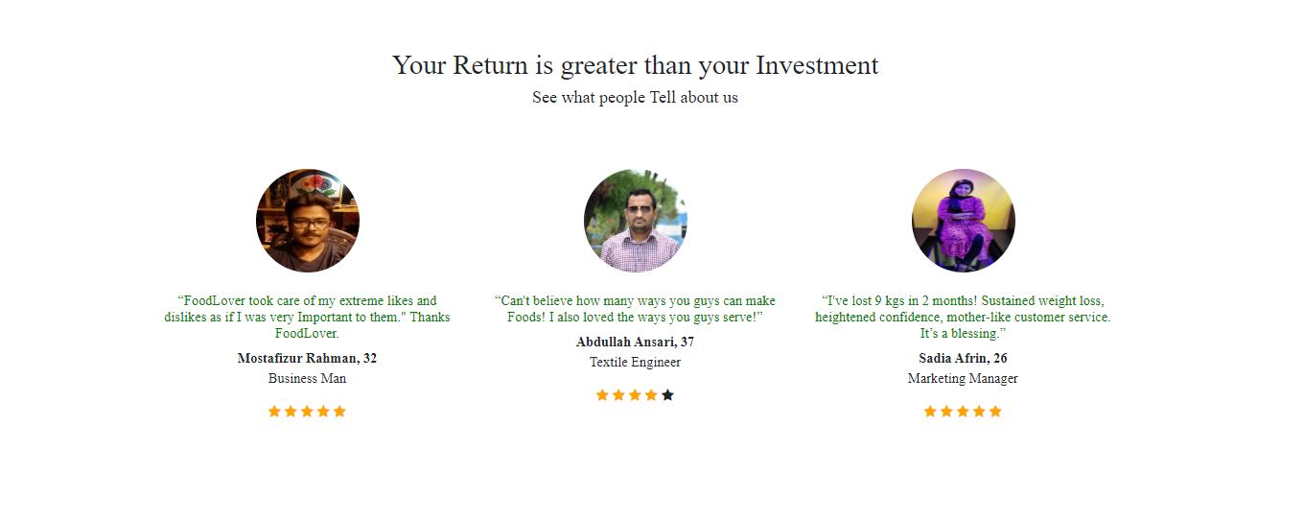
Implemented Work cont'd
Figure-7: Review section design for Food Lover

Slide 15
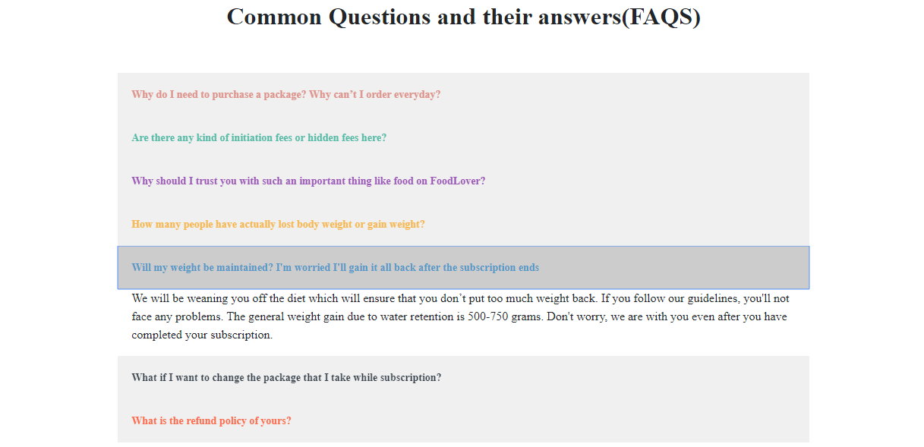
Implemented Work cont'd
Figure-8: FAQS section design for Food Lover.

Slide 16
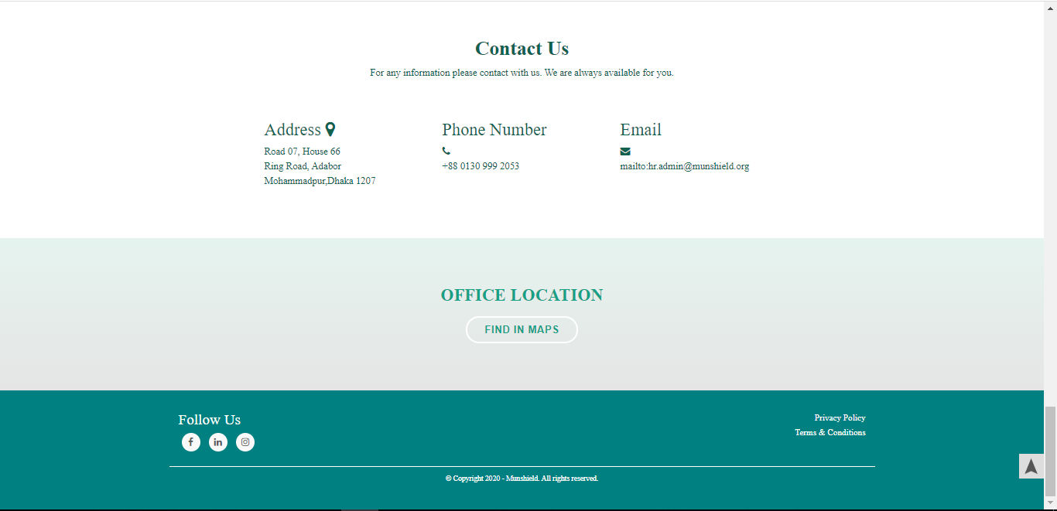
Implemented Work cont'd
Figure-9: Contact Us section design for Food Lover.

Slide 17
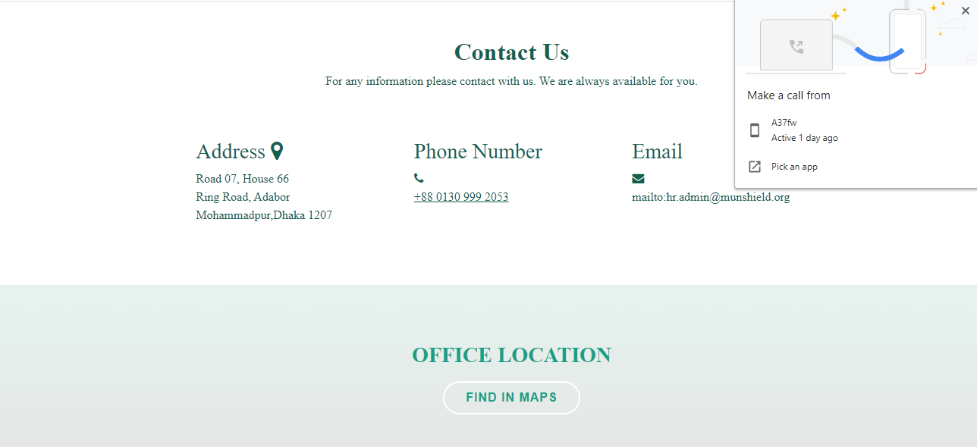
Implemented Work cont'd

Slide 18
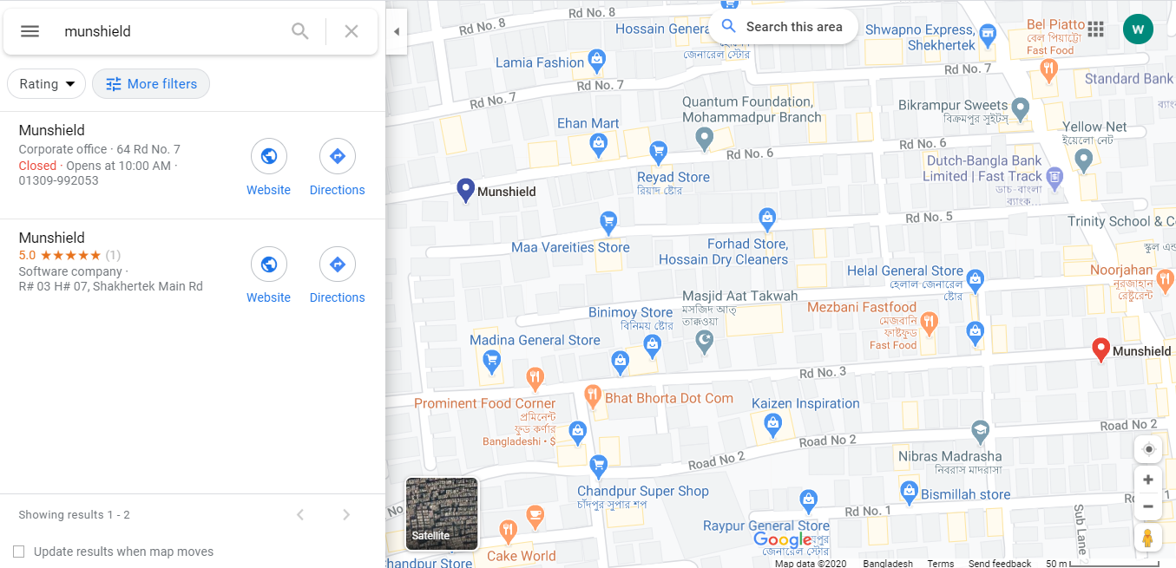
Find In Google Maps

Slide 19
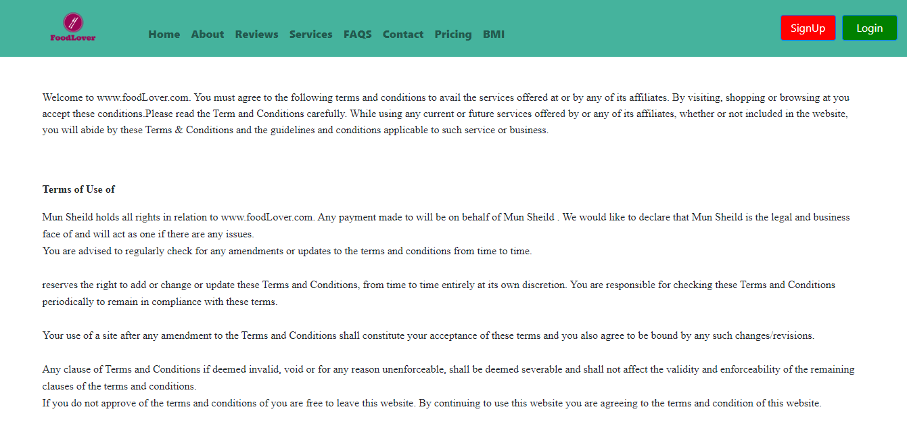
Implemented Work cont'd
Figure-11: Terms & Condition page designed for Food Lover.

Slide 20
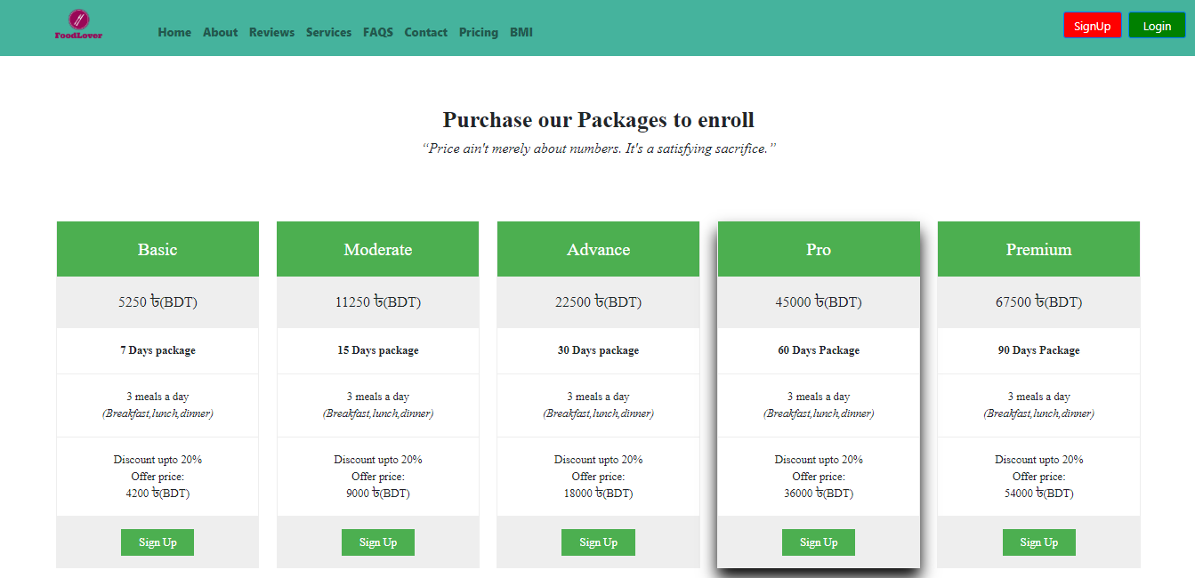
Implemented Work cont'd
Figure-12: Pricing page design for Food Lover.

Slide 21
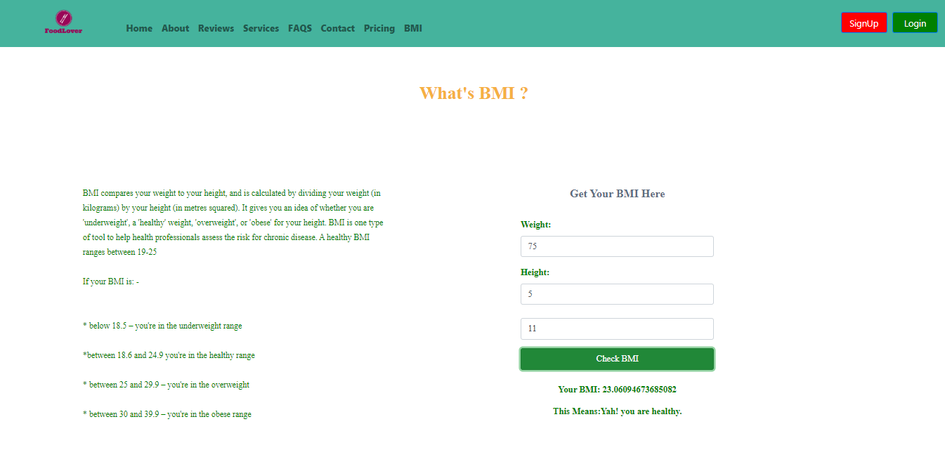
Implemented Work cont'd
Figure-13: BMI page design for Food Lover.

Slide 22
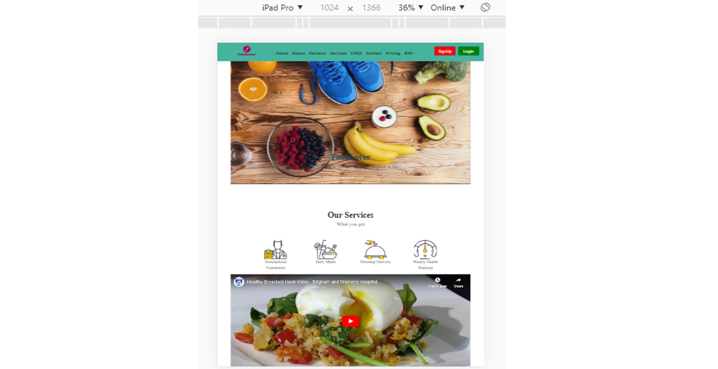
Figure-14: Responsive view of Food Lover.

Slide 23
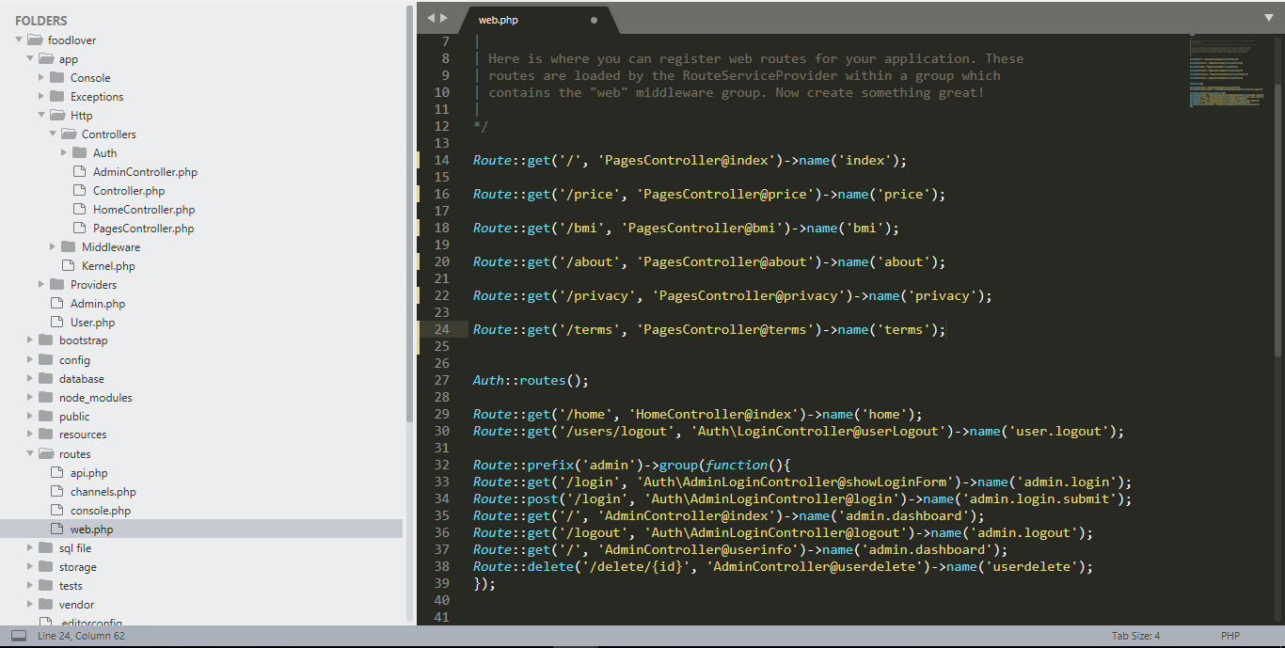
Figure-15: Route code of Food Lover.

Slide 24
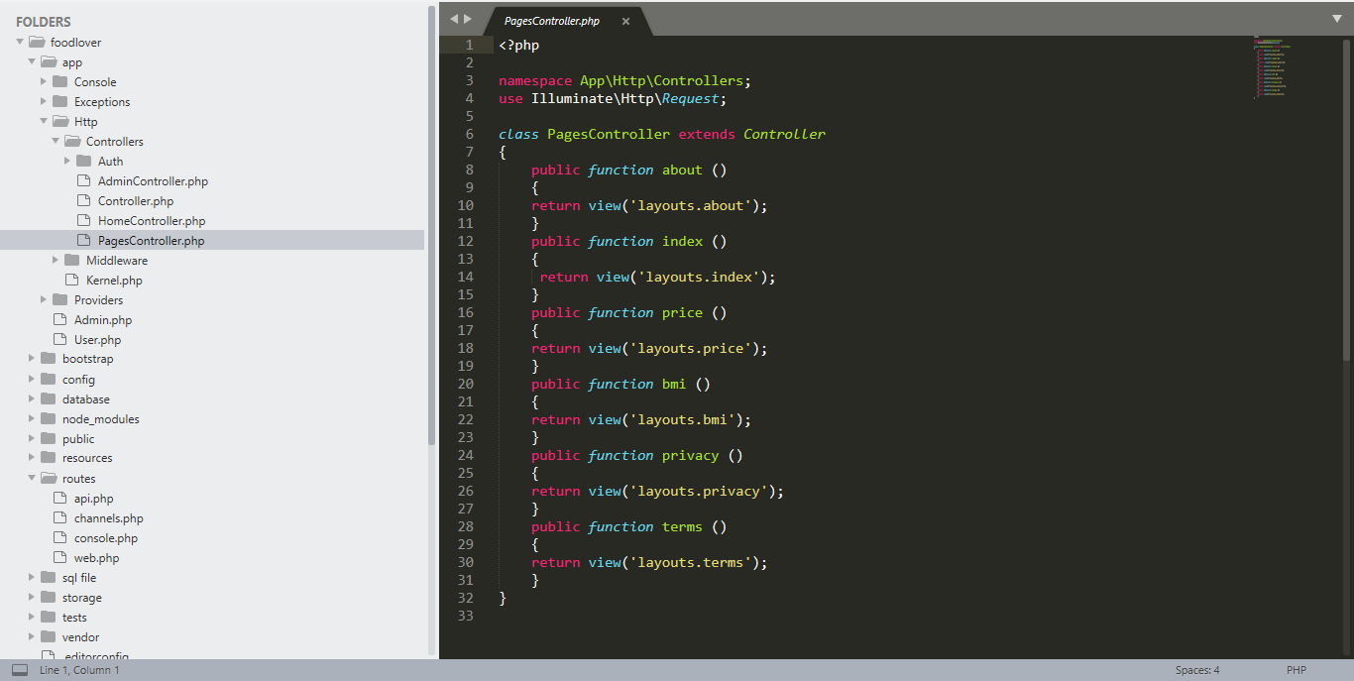
Figure-16: Controller code of Food Lover.

Slide 25
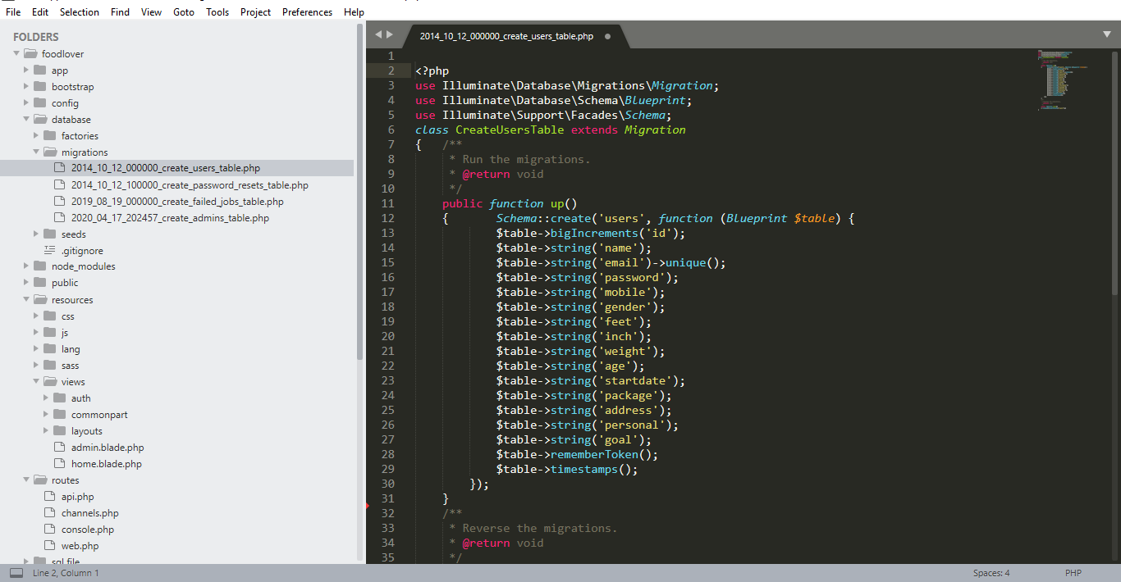
Figure-17: Creating model code of Food Lover.

Slide 26
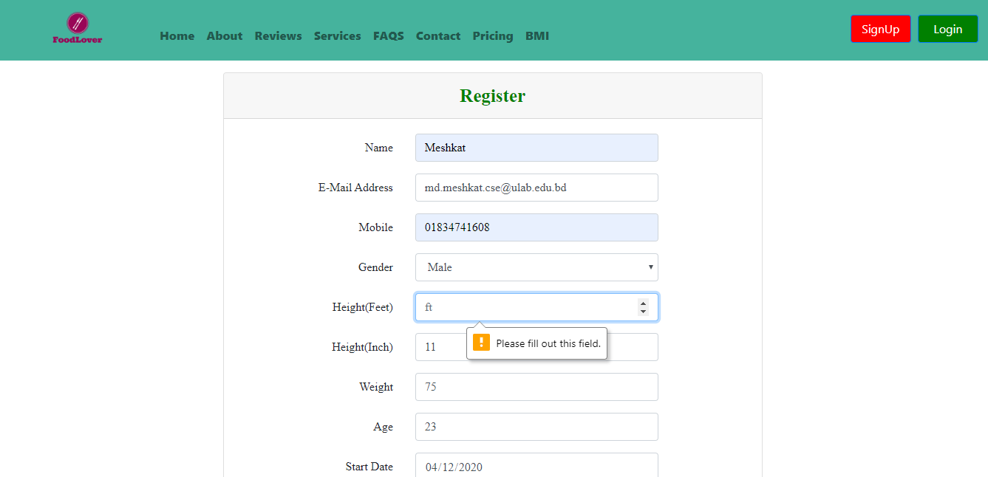
Implemented Work cont'd
Figure-18: Sign Up page design for Food Lover.

Slide 27
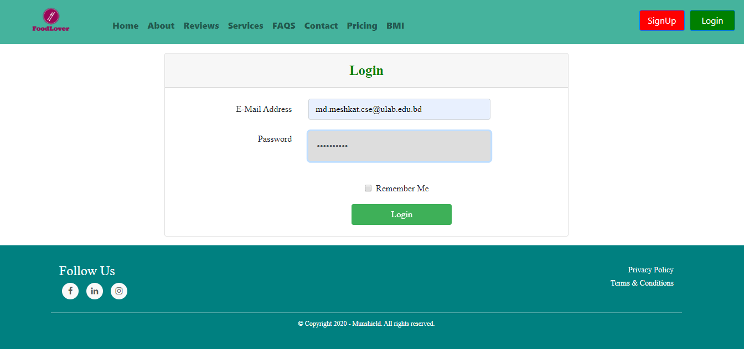
Implemented Work cont'd
Figure-19: Login page design for Food Lover.

Slide 28
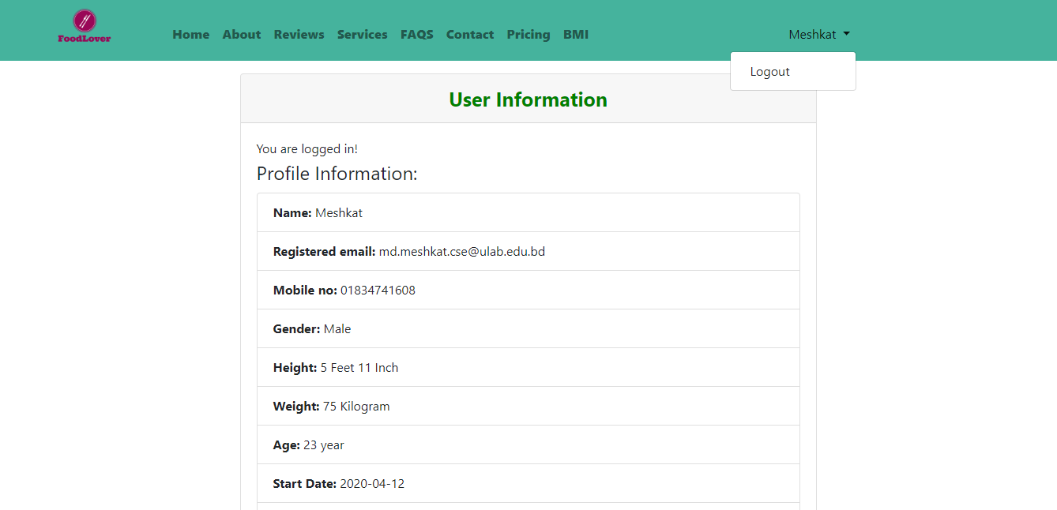
Implemented Work cont'd
Figure-20: User profile in Food Lover.

Slide 29
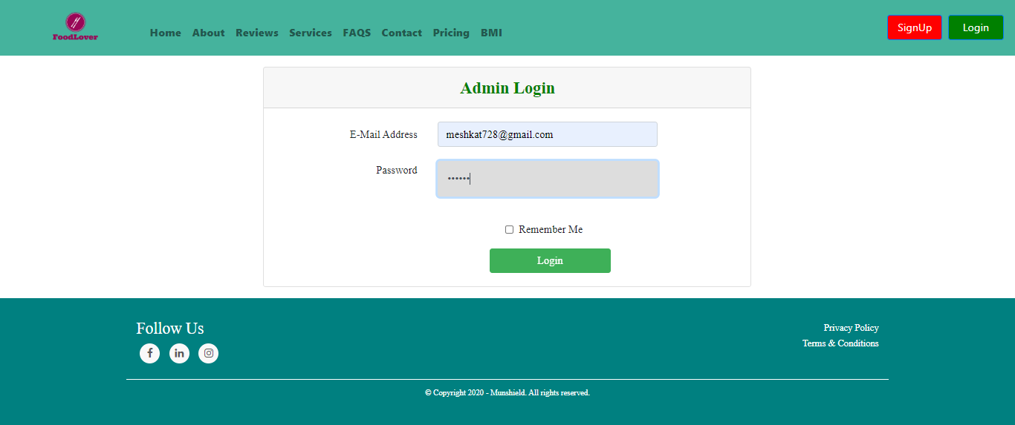
Implemented Work cont'd
Figure-21: Admin login in Food Lover.

Slide 30
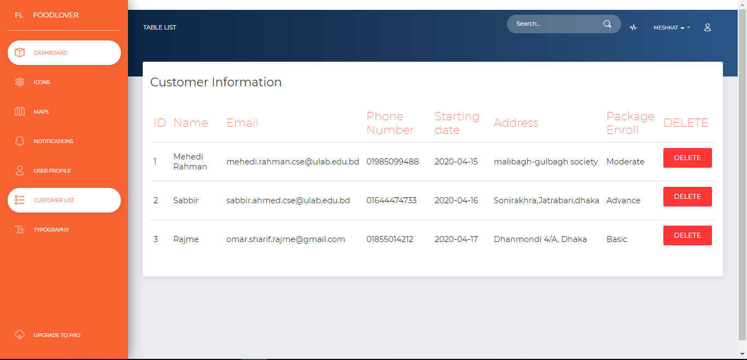
Implemented Work cont'd
Figure-22: Inside of admin panel in Food Lover

Slide 31
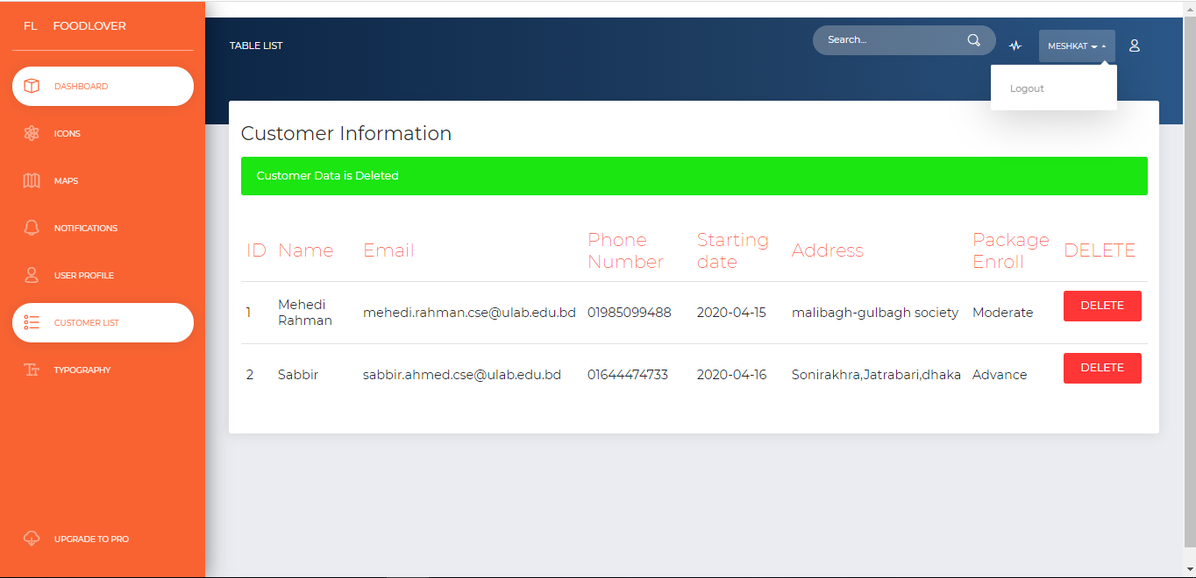
Implemented Work cont'd
Figure-23: Delete account in admin panel.

Slide 32
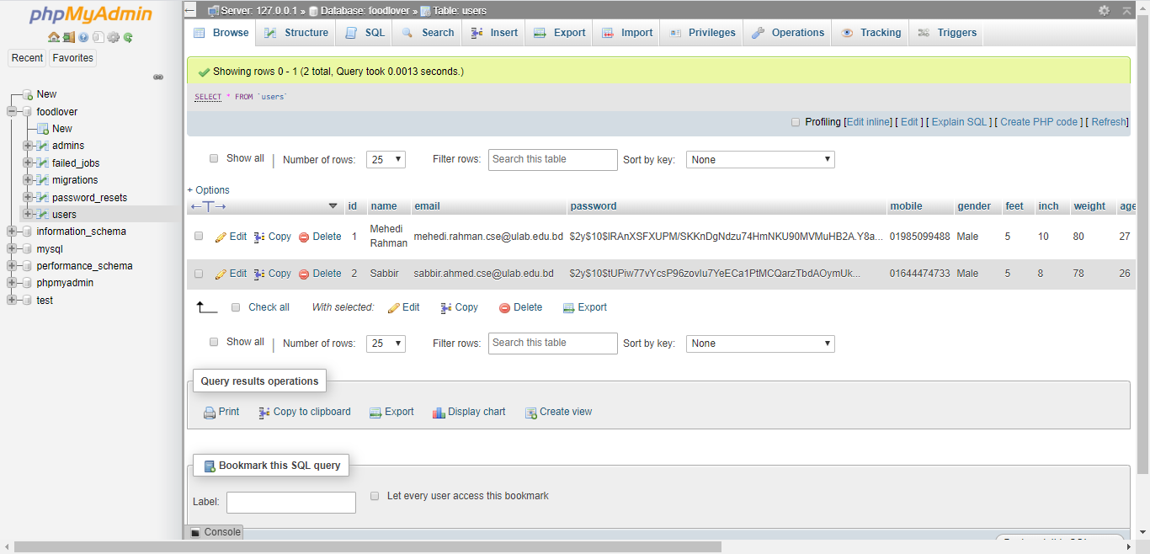
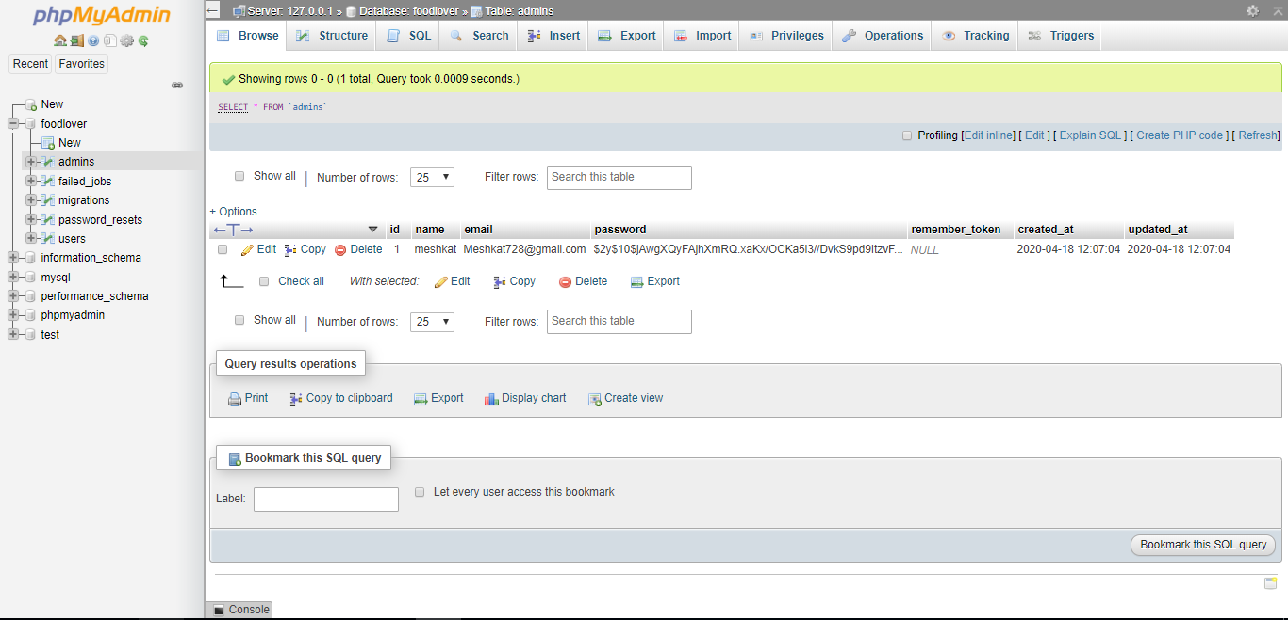
Implemented Work cont'd
Figure-24: Database Images of the Project.

Slide 33

Thank You

